Slide 1
Lecture #1

Slide 2
Unit 1 a: Spreadsheet functions to organize data
Cell reference styles
Creating and working with formulas
Text functions
Date and time functions
Lookup and reference functions
Mathematical and statistical functions
Information and volatile functions
Logical and financial functions
Formula auditing
Error handling
String functions

Slide 3
1. Cell reference styles
There are two types of cell references:
Relative references change when a formula is copied to another cell.
Absolute references, on the other hand, remain constant no matter where they are copied.
INT510, Lovely Professional University, Phagwara

Slide 4
2. Creating and working with formulas
Select a cell where you want to output the result.
Type the equal symbol (=), and then type the equation you want to calculate.
Press the Enter key to complete your formula. Done!
Here is an example of a simple subtraction formula in Excel: =100-50
INT510, Lovely Professional University, Phagwara

Slide 5
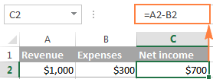
Write formulas in Excel using cell references
INT510, Lovely Professional University, Phagwara
Notes:
https://www.ablebits.com/office-addins-blog/create-formulas-excel/

Slide 6
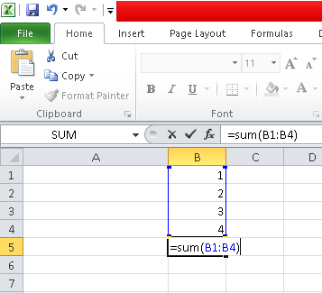
Create a formula in Excel by using the Function
Find the function you want to use
Specify the function arguments.
Complete the formula.
INT510, Lovely Professional University, Phagwara

Slide 7
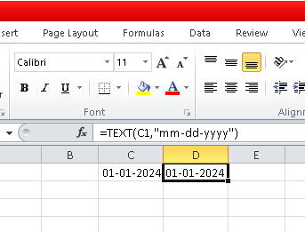
3. TEXT function
The TEXT function in Excel converts a numeric value to a text strings.
syntax TEXT(value, format_text)
  Value - the numeric value to be converted to text.
  Format_text - the format that you want to apply.
INT510, Lovely Professional University, Phagwara

Slide 8
TEXT function with dates and times
Format code | Description | Examples
d | Day of month, or day of week | d - one or two-digit number without a leading zero (1 to 31) dd - two-digit number with a leading zero (01 to 31) ddd - three-letter abbreviation (Mon to Sun) dddd - full name of day of week (Monday to Sunday)
m | Month (when used as part of a date) | m - one or two-digit number without a leading zero (1 to 12) mm - two-digit number with a leading zero (01 to 12) mmm - abbreviated month (Jan to Dec) mmmm - full name of month (January to December)
y | Year | yy - two-digit number (e.g. 06 meaning 2006 or 16 meaning 2016) yyyy - four digit number (e.g. 2006, 2016)
h | Hour | h - one or two-digit number without a leading zero (1 to 24) hh - two-digit number with a leading zero (01 to 24)
m | Minute | m - one or two-digit number without a leading zero (1 to 60) mm - two-digit number with a leading zero (01 to 60)
s | Second | s - one or two-digit number without a leading zero (1 to 60) ss - two-digit number with a leading zero (01 to 60)
AM/PM | Time represented as a 12-hour clock, followed by "AM" or "PM"
INT510, Lovely Professional University, Phagwara

Slide 9

TEXT function format codes
Code | Description
0 | Digit placeholder that displays insignificant zeros.
# | Digit placeholder that does not display extra zeros.
? | Digit placeholder that leaves a space for insignificant zeros but doesn't display them. It is generally used to align numbers in a column at a decimal point.
. (period) | Decimal point
, (comma) | Thousands separator.
INT510, Lovely Professional University, Phagwara

Slide 10
4. Date and time functions
DATE(year, month, day) returns a serial number of a date based on the year, month and day values that you specify.
Returns a serial number corresponding to 31-Dec-2023. | 31-12-2023 | "=DATE(2023, 12, 31)"
returns the first day of the current year and month. | 05-01-2024 | "=DATE(YEAR(TODAY()), MONTH(TODAY()),5)"
subtracts 5 days from given date | 15-05-2015 | "=DATE(2015, 5, 20)-5"
INT510, Lovely Professional University, Phagwara

Slide 11
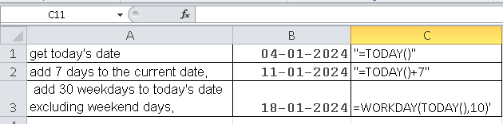
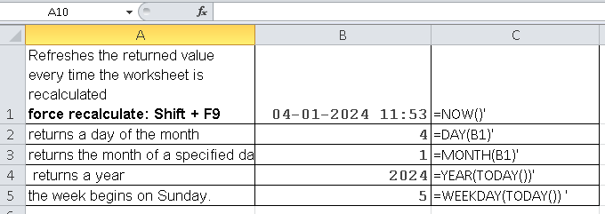
Date and time functions
INT510, Lovely Professional University, Phagwara

Slide 12
5. Lookup and reference functions
The LOOKUP function in Excel can perform the simplest types of vertical and horizontal lookups.
Pros: Easy-to-use.
Cons: Limited functionality, cannot work with unsorted data
  (requires sorting the lookup column/row in ascending order).
INT510, Lovely Professional University, Phagwara

Slide 13
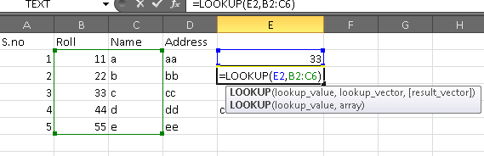
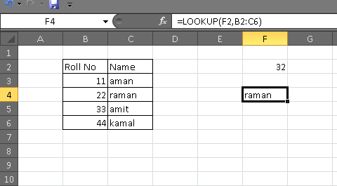
LOOKUP
INT510, Lovely Professional University, Phagwara

Slide 14
VLOOKUP / HLOOKUP function
Pros: Easy to use, can return exact and approximate matches.
Cons: Can only search in the topmost row of the lookup table, is affected by the insertion or deletion of rows, a lookup value should be under 255 characters.
INT510, Lovely Professional University, Phagwara

Slide 15

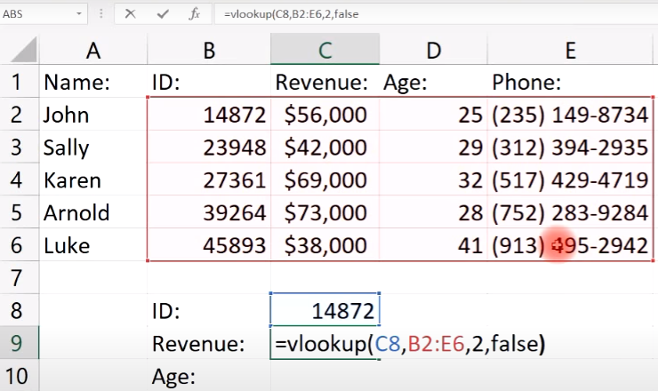
vlookup
INT510, Lovely Professional University, Phagwara
Notes:
https://www.youtube.com/watch?v=-DELnagpXEs (vlookup)

Slide 16
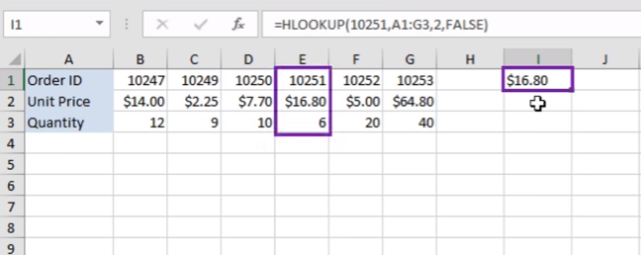
hlookup
INT510, Lovely Professional University, Phagwara

Slide 17
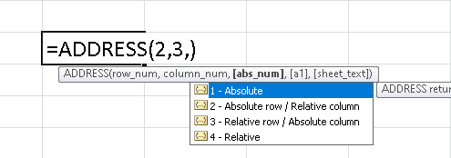
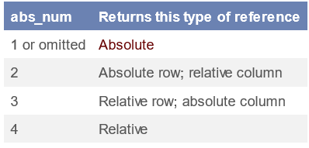
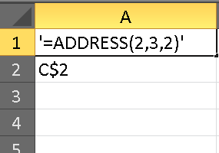
Reference function in help
A | B | C
Formula | Description | Result
=ADDRESS(2, 3) | Absolute reference | $C$2
=ADDRESS(2, 3, 2) | Absolute row; relative column | C$2
INT510, Lovely Professional University, Phagwara

Slide 18
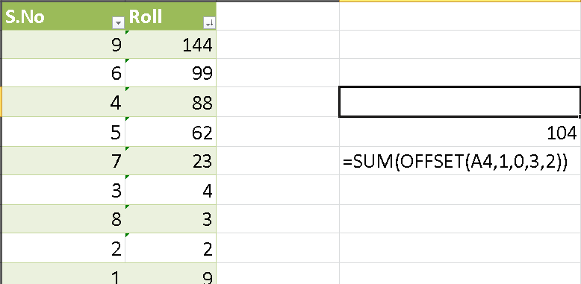
offset
INT510, Lovely Professional University, Phagwara

Slide 19
6. Mathematical and Statistical Functions in Excel
Functions related to statistics is present, like mean, median, mode, etc.
Integral statistical functions:
  COUNT used for counting the number of cells that have a number.
  COUNTA used for counting everything.
  COUNTBLANK solely counts empty or blank cells.
  COUNTIFS count on one or more condt. ie =COUNTIFS(B8:B13,">2",B8:B13,"<5")
INT510, Lovely Professional University, Phagwara

Slide 20
Contd…
MAX , MIN returns the highest/ lowest numeric.
LARGE, SMALL return the nth largest/smallest value.
MEAN: average
MEDIAN: average of the two middle numbers.
MODE: returns the most commonly recurring number
SUM, AVERAGE
MOD (remainder)
ROUND [=ROUND(23.666,2)]
INT510, Lovely Professional University, Phagwara

Slide 21
7. Information and volatile functions
Information Formulas in Excel are used get information about the worksheets and its contents like the current row number, whether a cell has an error, the type of value a cell has etc.
      Column() MS Excel Formula [=column(C4) … 3]
      Isblank() MS Excel Formula [=ISBLANK(C4) … FALSE]
      Iserror() MS Excel Formula [=ISERROR(C4) …FALSE]
      Isnumber() MS Excel Formula [=ISNUMBER(B8) ..TRUE]
      Istext() MS Excel Formula [=ISTEXT(C4) …TRUE]
      Row() MS Excel Formula [=ROW(C4) … 4]
INT510, Lovely Professional University, Phagwara
Notes:
https://chandoo.org/excel-formulas/information-functions.shtml#:~:text=Information%20Formulas%20in%20Excel%20are,value%20a%20cell%20has%20etc.

Slide 22
Contd…
Volatile functions are functions in which the value changes each time the cell is calculated.
The value can change even if none of the function's arguments change.
Eg.
=NOW() [ update the sheet by SHIFT+ F9]
INT510, Lovely Professional University, Phagwara

Slide 23
8. Logical and financial functions
# Fun. | It Returns | Formula Example | Formula Description
AND | TRUE if all of the arguments are TRUE. | =AND(A2>=10, B2<5) | returns TRUE if a value in cell A2 is greater than or equal to 10, and a value in B2 is less than 5, FALSE otherwise.
OR | TRUE if any argument evaluates to TRUE. | =OR(A2>=10, B2<5) | returns TRUE if A2 is greater than or equal to 10 or B2 is less than 5, or both conditions are met. If neither of the conditions it met, the formula returns FALSE.
XOR | a logical Exclusive Or of all arguments. | =XOR(A2>=10, B2<5) | returns TRUE if either A2 is greater than or equal to 10 or B2 is less than 5. If neither of the conditions is met or both conditions are met, the formula returns FALSE.
NOT | the reversed logical value of its argument. | =NOT(A2>=10) | The formula returns FALSE if a value in cell A1 is greater than or equal to 10; TRUE otherwise.
INT510, Lovely Professional University, Phagwara
Notes:
https://www.ablebits.com/office-addins-blog/excel-and-or-xor-not-functions/

Slide 24
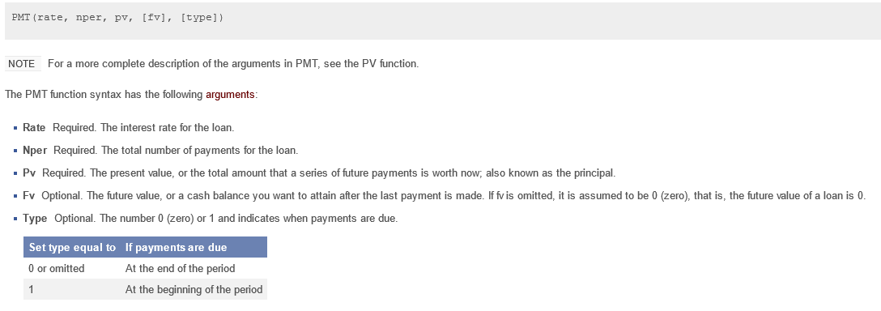

Financial functions
PMT: Payment Amounts for a Loan
INT510, Lovely Professional University, Phagwara

Slide 25
Excel Example List
INT510, Lovely Professional University, Phagwara

Slide 26
9. Formula auditing
Formula auditing is an essential tool in Excel that enables users to show the relationship between formulas and cells.
Excel Formula Auditing toolbar helps the user to quickly and easily find:
the cells contribute to calculating a formula present in the active cell.
the formulas that refer to the active cell.
INT510, Lovely Professional University, Phagwara

Slide 27
Different ways using which you can audit a formula:
Trace Precedents
Trace Dependents
Remove Arrows
Show Formulas
Error Checking
INT510, Lovely Professional University, Phagwara

Slide 28
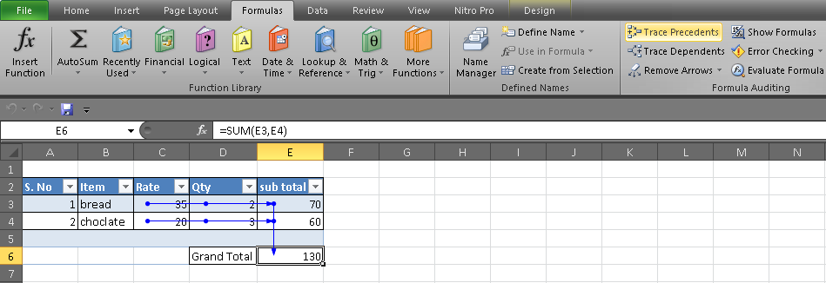
Trace Precedents
INT510, Lovely Professional University, Phagwara

Slide 29
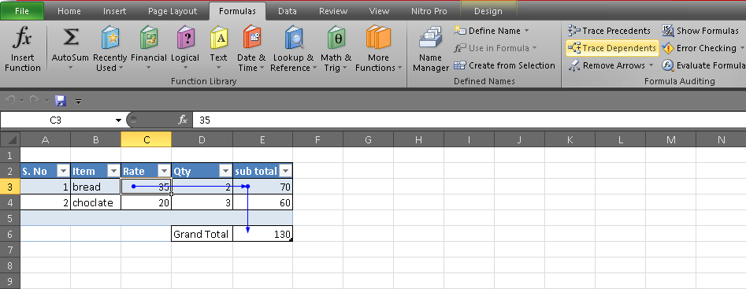
Trace Dependents
INT510, Lovely Professional University, Phagwara

Slide 30
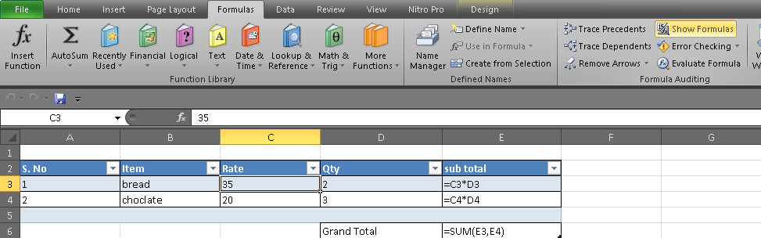
Show Formulas
INT510, Lovely Professional University, Phagwara

Slide 31
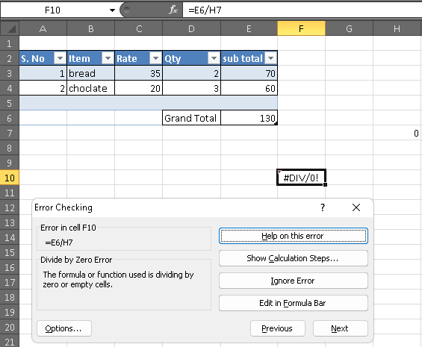
Error Checking
INT510, Lovely Professional University, Phagwara

Slide 32
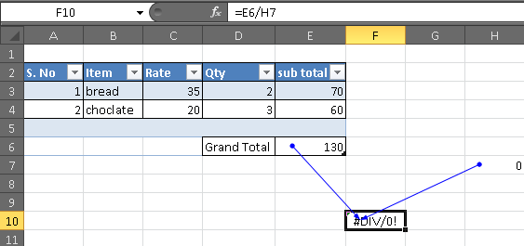
Error Checking: trace error
INT510, Lovely Professional University, Phagwara

Slide 33
10. Error handling: error types
Error Types | Description | Example
#VALUE! | Data type given for a function doesn’t match. | ="A"+1
#REF! | When a cell reference is deleted or moved. | =A1+A2 use 'ctr' + '-'
#DIV/0! | When operation attempts to divide by zero. | =A1/0
#NAME? | When excel can’t find a named range. | =A*1
#NULL! | When Excel can’t figure out the range specified in a cell. | =SUM(A1 C1)
#N/A | When a function like MATCH or VLOOKUP cannot find the value. | =MATCH("A",{"B","C"},0)
INT510, Lovely Professional University, Phagwara

Slide 34
Error handling :False Errors
######## : the cell column is too narrow to display the value.
#GETTING_DATA is a message that can appear in Excel when a large or complex worksheet is being calculated.
INT510, Lovely Professional University, Phagwara

Slide 35
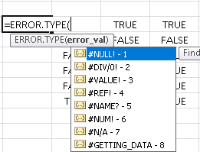
Error handling functions
ISNA function evaluates an #N/A error as TRUE
ISERR function evaluates all error types except for #N/A.
ISERROR function catches all error types.
ERROR.TYPE function will return a number from 1 through 8.
IFERROR function combines the IF and ISERROR functions.
(Eg. =IFERROR(F16, "Error")
INT510, Lovely Professional University, Phagwara

Slide 36
11. String functions
=UPPER(text)
=UNICODE(text)
UNICHAR function
=TRIM(text)
=SEARCH(find text, within text)
=REPT(text, number of times)
=REPLACE("redcar",1,3,"blue")
=PROPER(text) , =LOWER(text), =UPPER(text)
=CLEAN(text)
INT510, Lovely Professional University, Phagwara

Slide 37



